Slide 1
Credit Card Fraud Detection
Yash Murthy
July 20,2022
COMP 4449

Slide 2
Importance
Credit Cards/Digital Transactions are an integral part of modern society
According to the Nilson Report conducted in 2020, there were 368.92 Billion purchase transactions for goods and services worldwide in 2018¹
Roughly 1.01 billion per day
Around half of all Americans have experienced a fraudulent charge on their credit/debit cards
Median charge amount of $62 resulting in approximately $8 billion dollars per year
About 40% of cardholders do not have email or text alerts to note them of fraud²
Automated detection of fraudulent transactions can increase efficiency and save users time
Notes:
https://www.cardrates.com/advice/number-of-credit-card-transactions-per-day-year/#:~:text=Credit%20Card%20Transactions%20Globally,every%20day%20around%20the%20world.
https://www.security.org/digital-safety/credit-card-fraud-report/

Slide 3
Dataset Overview
Transaction data was taken from European transactions over a 2 day period in 2013
Dataset was heavily imbalanced
Total of 284,807 transactions, 492 of those being fraudulent (0.172%)
Binary class label 0 (Non-Fraud) and 1 (Fraud)
Due to confidentiality issues, only 28 features (V1 - V28) obtained from PCA and the transaction Amount and Time (time elapsed since original transaction) were included

Slide 4
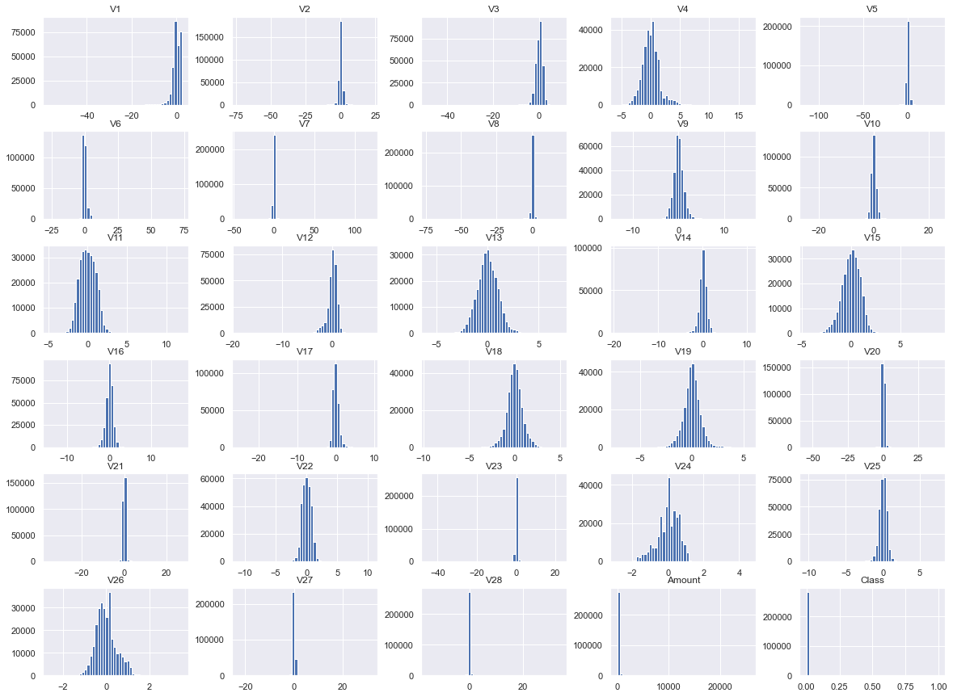
Data Preparation
Features V1-28 were already normalized and obtained through PCA analysis so kept all features
No null values
Dropped duplicate values (10 k)
Due to high variance of the ‘Amount’ feature, I decided to standardize these values

Slide 5
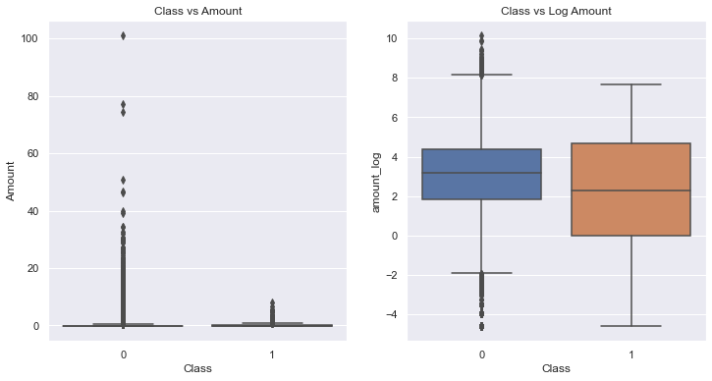
Standardization of Transaction Amount
Two standardization techniques
StandardScalar
Log Scaling
Minimum difference observed in Log Scaling, and proceeded with these transformed values for amount

Slide 6
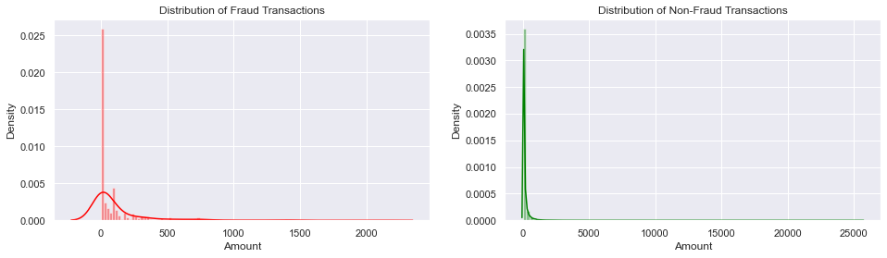
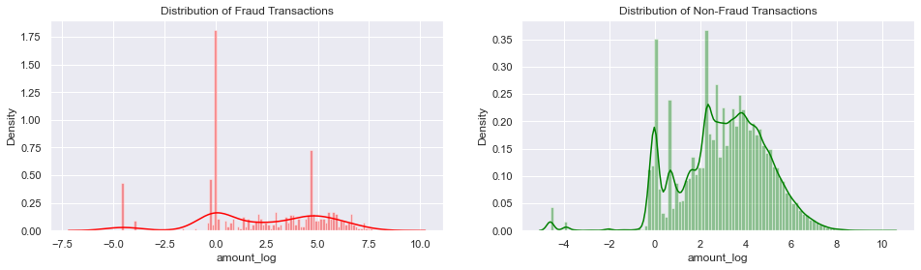
Visualization of Amount Transformation
Pre Log-Scale
Post
Log-Scale

Slide 7
Techniques Used and Time Allotment
3 Classifier Techniques (80/20 Train-Test Split)
Decision Tree
Logistic Regression
Random Forest
2 methods to deal with Class Imbalance
SMOTE
ADASYN
25% dedicated to data preparation, 75% dedicated to analysis

Slide 8



Classification Reports
Important to note that F1 is the best metric in the case of severely unbalanced datasets
F1 score: 2 x ((Precision x Recall) / (Precision + Recall))
Ranked by ascending F1 score (worst to best)
Logistic Regression
Random Forest
Decision Tree

Slide 9
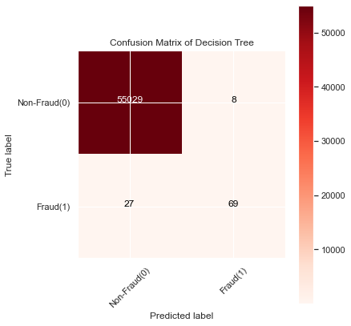
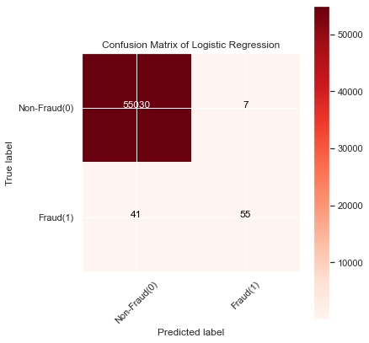
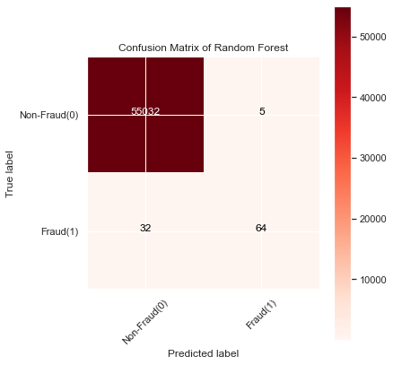
Confusion Matrices

Slide 10
Dealing with Imbalance: SMOTE
Oversampling technique that creates synthetic examples in minority class which are similar to those that already exist (vs simply replicating them)
SMOTE (Synthetic Minority Oversampling Technique) Process includes the following:
Identifying the feature vector and its nearest neighbor.
Taking difference between the two.
Multiplying the difference with a random number between 0 and 1.
Identifying a new point on the line segment by adding the random number to the feature vector.
Repeat the process for identified feature vectors.
Limitations include when these synthetic examples are created without considering to majority class, which can result in ambiguous synthetic data³
Notes:
3. https://www.analyticsvidhya.com/blog/2020/10/overcoming-class-imbalance-using-smote-techniques/

Slide 11
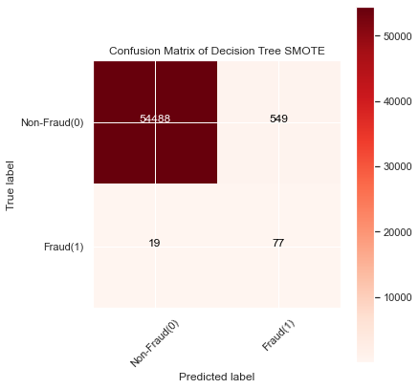



SMOTE Results

Slide 12
Dealing with Imbalance: ADASYN
ADASYN (Adaptive Synthetic) algorithm uses weighted distribution for different minority class examples according to their difficulty of learning to generate synthetic data
Advantages:
Can reduce bias introduced by class imbalance
Shifts classification decision boundary towards more difficult examples in an adaptive manner
Weaknesses:
Minority examples that are sparsely distributed (may be outliers) may be difficult to classify
Precision may lack due to the adaptability nature of algorithm
Notes:
https://medium.com/@ruinian/an-introduction-to-adasyn-with-code-1383a5ece7aa#:~:text=ADASYN%20(Adaptive%20Synthetic)%20is%20an,%E2%80%9Charder%20to%20learn%E2%80%9D%20examples.

Slide 13
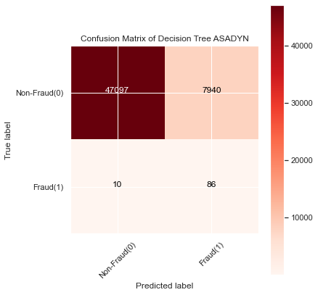


ADASYN Results

Slide 14
Conclusion
Decision Tree Classifier Default was the most accurate model
Imbalanced datasets are difficult to analyze when building a model, but there are techniques we can use to try and balance the data
Explanation of features V1-V28 may help gain better understanding of the data and help eliminate features during feature selection

